Slide 1
WHAT IS TRAUMA?
Trauma is the absence of connection to Core Being --in consciousness, body and energetically. It is a source of our false sense of self and our negative beliefs.
Our ego uses it to judge and our separated self feeds off it so it remains in distortion.

Slide 3
TRAUMA REPEATS ITSELF
We anticipate, orient to, and react to stimuli that directly or indirectly resemble the original traumatic experience or its context.
Why do we do this? Patterned Learning. Trauma trains our brain/physiology and energy system for programmed reaction.

Slide 4
WHAT TRAUMA “Stories” Tend to Repeat in Your Life?
Where do you hold them in your body/energy system?
What negative beliefs are linked to them?
What are the positive alternative beliefs to adopt?
Where is the hara broken that keeps them repeating and why?

Slide 5
CLINICIANS Call Patterned Learning PROCEDURAL MEMORY
It is learned patterns of behavior, movement, gestures, autonomic arousal patterns, and emotional and cognitive tendencies.
It is often unconscious and reactive in nature.
It is why the story repeats and choice is eliminated.

Slide 6
Me-B Guides Must Help Clients Challenge Procedural Learning To Re-pattern your ME-B SYSTEM or Trauma Remains Affixed in Place
Procedural “patterned” Learning Imprints include:
cultural norms,
cognitive behaviors, emotions, thoughts and actions,
sensations and energetic patterns,
beliefs systems, transferences, projections and more.

Slide 7
List of Trauma Related Procedural Tendencies
Freeze: mute, can’t move
Hyper-arousal: hyper-vigalence, emotionally reactive, fight, flight, fear!
Hypo-arousal: flat affect, numb, feel dead, collapse
Window of Tolerance is the moderate, regulated arousal.

Slide 8
DISORGANIZED/DISORIENTED ATTACHMENT
Prevalent among Abused
Borderline Personality Disorders; Dissociative disorders
The more prolonged the abuse and trauma, the more severe the attachment disorder
Leaves one vulnerable to intolerable sensations, thoughts, needs and affects (sensory integration issues too)

Slide 9
Window of Tolerance Guidelines
If too High, re-traumatize
If too low – hypo arousal, no contact with trauma
KEEP CLIENT IN THE WINDOW OF TOLERANCE!

Slide 10
DISREGULATION IS NECESSARY
Within the Window of Tolerance ONLY!
INFLUENCE THE RHYTHM OF THE ENERGY!
Both you and the Client Must Learn to Stay within The Window of Tolerance.
TRACK THE FIELD

Slide 11
Flooding to Maximize Window of Tolerance. Only for Advanced Clients
What is your edge? The more flooding you can manage and not lose your enlightened observer, the further you are on the ME-B Stages.

Slide 12
SIFTING INFORMATION
When trauma has been activated, people typically have trouble sifting through significant information from inconsequential information so they can determine if there is a threat.

Slide 13
Orienting Reflex/Stages of Orienting
Arousal is the first stage. It may be something as simple as noticing/not noticing a door slam.
Activity arrest to gather information. Usually a person stops what they are doing to determine if there is something wrong.
Sensory Alertness. Senses of smell, taste, hearing, kinesthetic, direct knowing, intuition kick in to determine if there is a real threat.
Muscular adjustments.
Scanning helps determine how to react. The body symptoms are eyes, then head movement.
Location in space. Where is the threat.
Identification and appraisal. Appraisal depends upon the person to separate past from present
Action. If the action is based on a malfunctioning higher brain, or a failure to activate the primal brain or sympathetic nervous system’s responses, then a client will replay the past in the present and thus re-traumatize themselves if they don’t respond appropriately to the stimuli.
Reorganization. In this final stage, re-organization occurs, the system returns to homeostasis, re-orienting to other objects/people/relationships appropriately and not based on defense and/or a programmed response. (Ogden, Pat; Trauma and the Body p. 76)

Slide 14
LEARN TO ORIENT IN A HEALTHY MANNER in ALL ME-B SYSTEMS
We can take in new information about safety by:
accurately evaluate threat,
(2) integrate a wide array of stimuli as perceived by our HSP and senses,
(3) notice what is old trauma being activated and what is new information,
(4) repattern/transform old trauma, so you can
(5) shift old patterns in Mind-Energy Body and new realities can be realized.

Slide 15
TRACK ENERGY AND BODY CUES TO PREVENT OVER/UNDER STIMULATION
Breath
Eyes
Head position, scanning, looking down or away
Shoulders collapsed or back
Facial expressions
Feet – soles rolled inward or outward or tucked under
Tightness or flaccid muscles
Posture
Sounds
Body movements, especially hands and torso
Body types as represented by the character structures
Notice your body too – it often mirrors what is happening in the client
Other cues your HSP identifies.

Slide 16
The Mind Alone Doesn’t Do It!
“The basic blueprint of our map of the world and the way we move through it consists of connections between the arousal system of the brain (the reptilian brain) and the interpretive system of the mammalian brain (the limbic system). These connections organize how all animals, including humans, organize their responses to sensory stimuli – and these responses, first and foremost, concern movement.” (Ogden, Pat Trauma and the Body p. xvii)
When trauma studies rediscovered the automatic activation of fixed action patterns in the mind and body it became clear, cognitive psychotherapy is ineffectual.

Slide 17
The ME-B Session Alone Doesn’t do it!
Trauma repatterns in the moment. It is paramount you teach your client skills to transform the trauma into personal power so they can practice 100,000 times (at least) in the moment, in their day-to-day incounters.
ME-B Sessions teach and lesson the trauma, but change happens in the moment!

Slide 18
ME-B TRAUMA METHODS
Positive Resourcing Techniques
Nervous System Replacement
Birth/Prenatal/Pre-birth/Ancestral Trauma
Back and Forth Techniques
Re-patterning and Reprocessing Techniques
Higher Brain/Primal Brain Reactionary Balance
Includes On and Off Table Techniques

Slide 19
Back and Forth Technique Is A Good Start
Move from Core Being to Trauma then back to Core Being
Only Put your Toe Into the “Pool” of Trauma
Especially when there is Low Ego Strength
Prevents Over-Identification

Slide 20
HIGHER BRAIN/PRIMAL BRAIN CAUTIONARY
Fight/Flight/Freeze are defensive reactions ruled primarily by the limbic system/primal brain.
The Higher Brain can prevent trauma processing if it (1) discounts what if feels or if it (2) discounts real threat because of hypo-arousal.
Teach your clients how to use the Enlightened Observer to mitigate obstacles created by the higher and limbic system/primal brain conflict.

Slide 21
Cautionary Conflict into Client Interaction
A client will often discount a emotional reaction because they feel they have “no right” to feel that way.
Don’t let clients bury emotional reactions with cognitive reasoning. Trauma must be aligned in all three systems.

Slide 22
Under which circumstances do you…
…Lose your voice, fail to speak out or object, or fail to state your needs,
…Collapse or be Submissive,
…Flight, move away from threat,
…Fight: emotional reactivity, movement toward threat, aggression,
…Freeze: stiffen, fast breathing, confusion, tense muscles,
Where is this held in your body/energy systems?

Slide 23
Release, Repattern and Replace (R3) Process
Begin greeting the client to your office, assessing their resourcing level and where they are in the 10 ME-B Stages of Transformation.
As the session progresses you will begin to guide them into the body to assess where the trauma is being held.
Then you will use any of the methods taught such as:
Core Distortion Healing – on or off the table;
“Anger Props” taught past class
Multi-dimensional Fabric, Centered Oneness, and/or Star Child Healings;
Other variations based on positive resourcing techniques taught, establishing safety/trust
Using HSP and tracking techniques to guide interventions;
Be creative, explore.
Make sure you:
track the empowerment of the enlightened observer and help the client make adjustments if needed;
base ME-B Therapist interventions on what the body, energy, client tells you;
intend to establish and rewire to a healthier “track” so re-patterning happens in all three systems; and
finish by brining in a higher vibrational frequency and consciousness.

Slide 24
Trauma sessions ideally end with success…feeling accomplishments/gain in understanding!

Slide 25
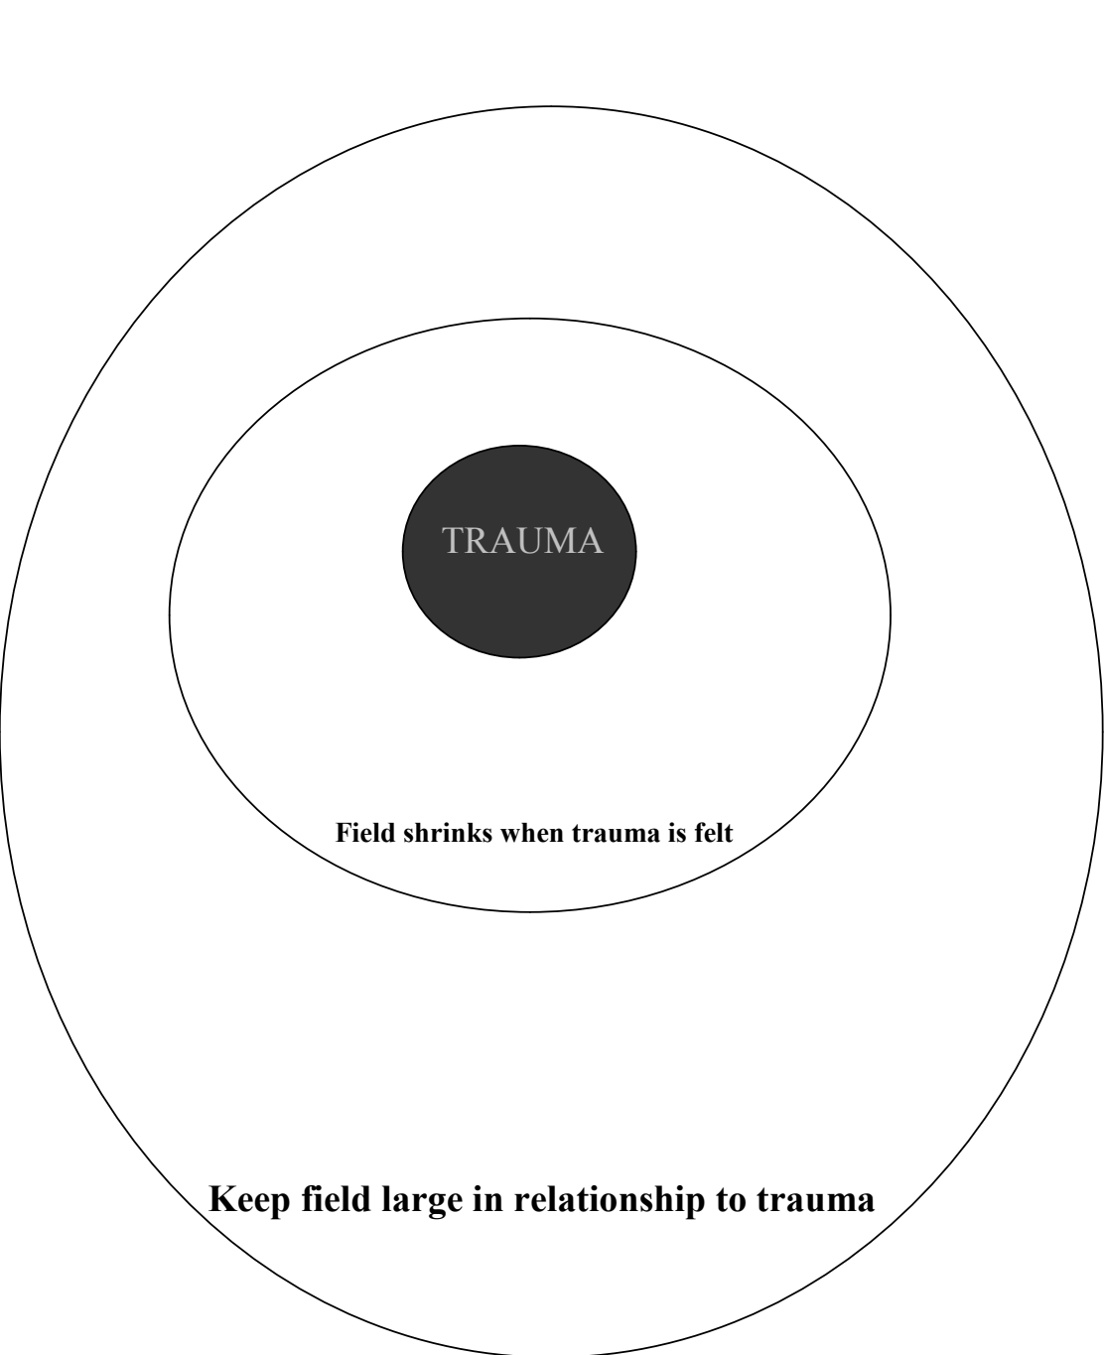

Slide 26
Remember, real Time Practice Is Needed Too
Mindfulness/Awareness of Patterned Learning In the moment is needed to Replace Trauma Programming. Review ME-B Steps.
10,000 times or more!

Slide 27
HOW DOES TRAUMA PRESENT IN THE THREE-SYSTEMS?

Slide 28
When Should Trauma Be Processed?
STRESS ACTIVATES DORMANT TRAUMA/DON’T PLAN TRAUMA PROCESSING DURING STRESSFUL TIMES

Slide 29
Experience Dependent Neurplasticity
Life and your relationship to ego, pain creates either healthy neuro structures or reactive neuro structures
Polyvagal Theory-Dorsal Vagal and Ventral Vagal

Slide 31
TRAUMA SHAKING AND MORE
http://www.youtube.com/watch?v=bPFbXdSGSkc&feature=related

Slide 32
Books!
The Intimate Enemy
Leader Effectiveness Training by Dr. Thomas Gordon
Character Styles; Stephen M. Johnson; isbn 0-393-70171-9
Sensing, Feeling, and Action, the Experimental Anatomy for the Body-Mind Centering; by Bonnie Cohen
From Conception to Crawling; Annie Brook
Susan Aposhyan, Naural Intelligence: Body-Mind Integration and Human Development
David Chamberlain, The Mind of Your Newborn Baby
Robert Karen, Becoming Attached: Unfolding the Mystery of the Infant-Mother Bond and Its Impact on Later Life
William Emerson; wemerson@home.com

